Slide 1


Sales, Marketing, Pricing and Communication Strategy Toolkit
Overview

Slide 2
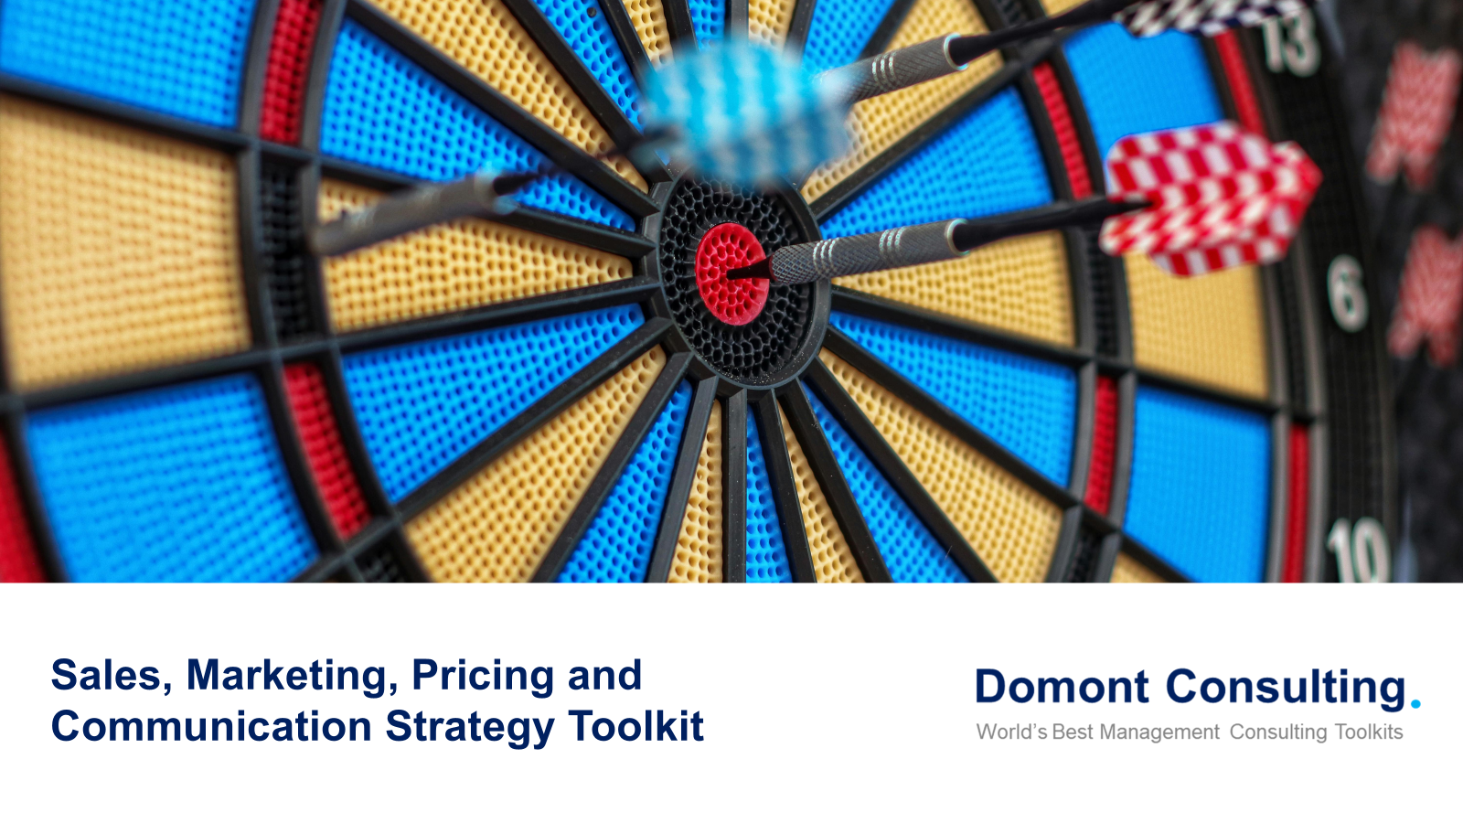
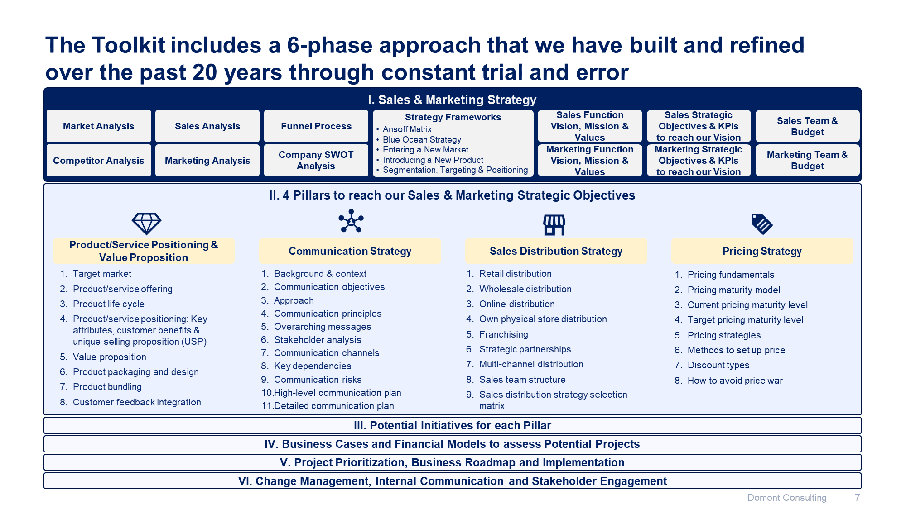
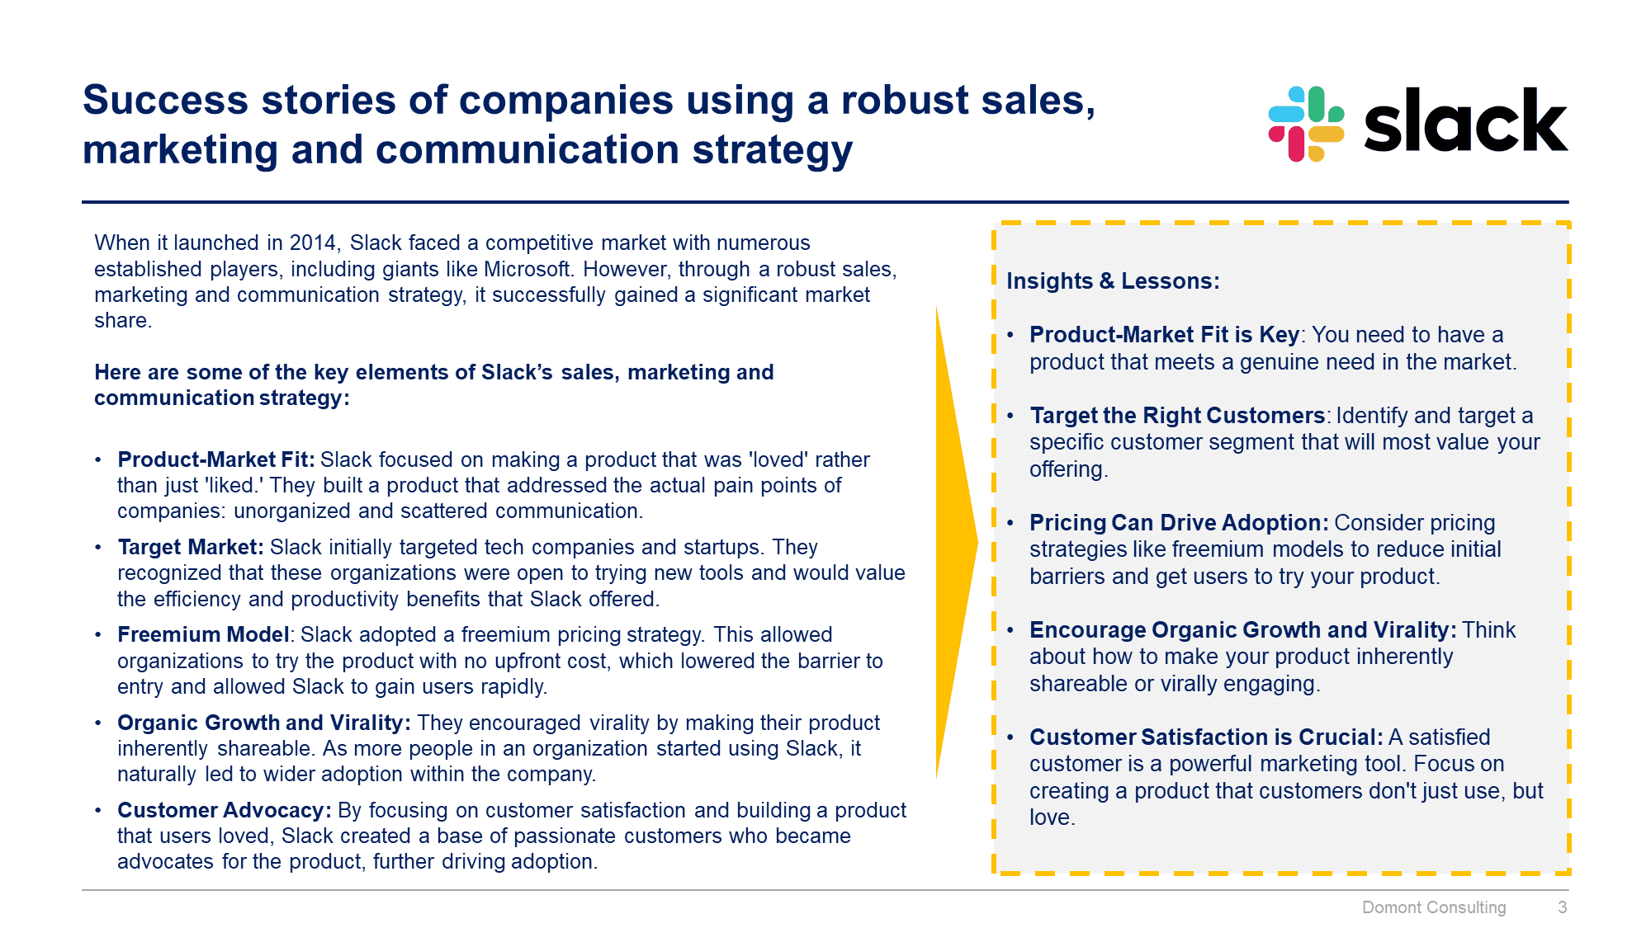
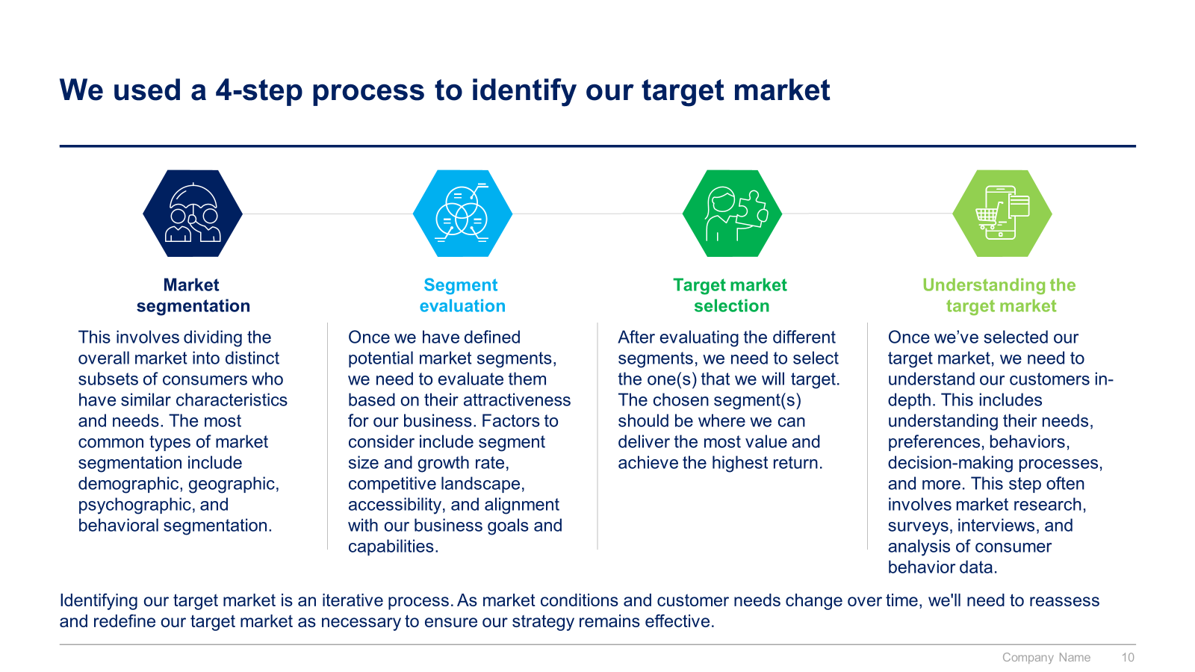
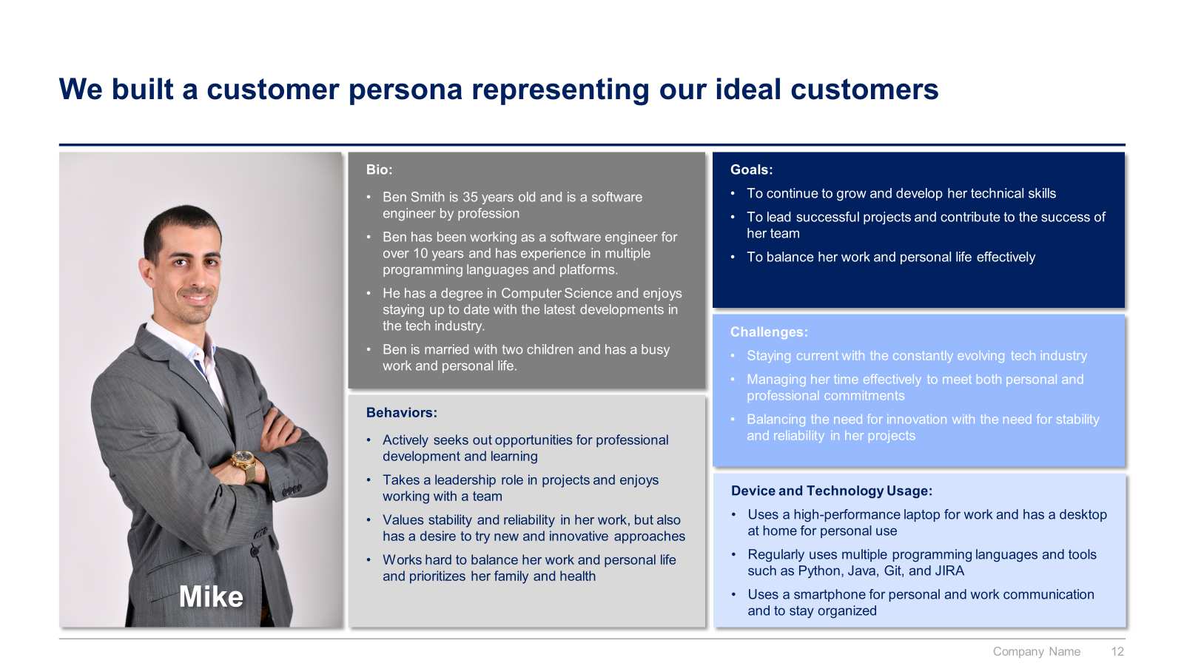
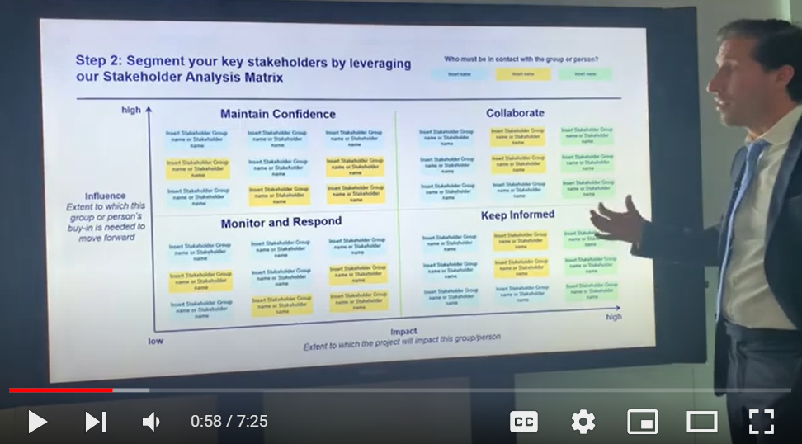
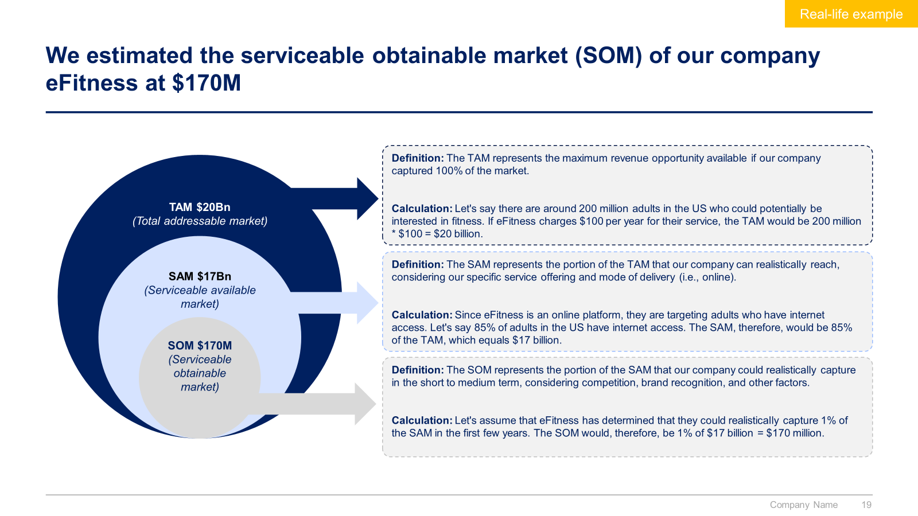
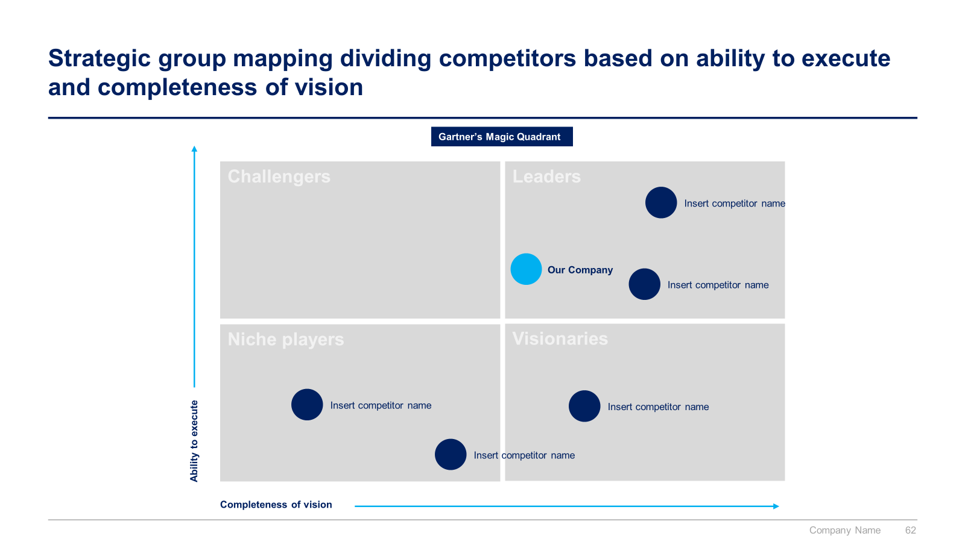
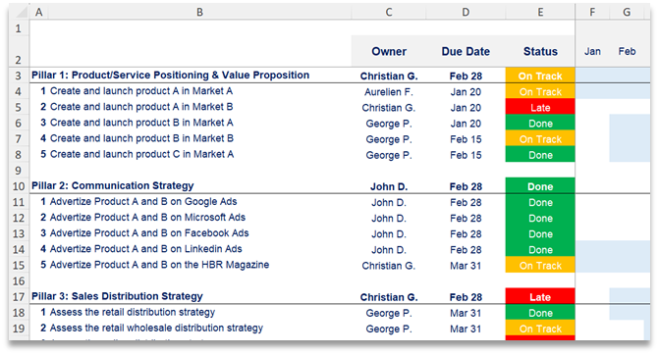

Slide 3


Introduction
This Toolkit was created by ex-McKinsey, Havas & Deloitte consultants. It is considered the world's best & most comprehensive Sales, Marketing, Pricing and Communication Toolkit. It includes all the Frameworks, Best Practices & Templates required to design and implement a robust Sales, Marketing, Pricing and Communication strategy.
Join the 200,000+ Executives, Consultants & Entrepreneurs who are already leveraging our Management Consulting Toolkits to improve the performance of their organization and boost their own career.
If you have any questions, send us an email at support@domontconsulting.com and one of our ex-McKinsey, Deloitte & BCG Management Consultants will get back to you within 2 business days.
Aurelien Domont
Management Consultant
Domont Consulting Managing Director

Slide 4


Success stories of companies using a robust sales, marketing, pricing and communication strategy
Sales, Marketing and Communication Strategy
Amazon’s Revenue ($bn)
Customer-Centric Approach: Amazon places a strong emphasis on customer satisfaction, offering a wide range of products, competitive pricing, and excellent customer service.
Personalization: They use data analytics to personalize the shopping experience, recommending products based on customer behavior and preferences.
Prime Membership: Amazon Prime offers benefits like free shipping, exclusive deals, and access to streaming services, which encourages customer loyalty and repeat purchases.
Innovative Marketing: Amazon uses a mix of digital marketing, social media, and traditional advertising to reach a broad audience. They also leverage user-generated content, such as reviews and ratings, to build trust.
Expansion and Diversification: Amazon continuously expands its product offerings and services, including cloud computing (AWS), streaming (Amazon Prime Video), and physical stores (Whole Foods).
With a compounded annual growth rate (CAGR) of 18%, Amazon's strategy has led to significant revenue growth over the years.
CAGR: +18%
2018
2019
2020
2021
2022
2023
2024

Slide 5

Success stories of companies using a robust sales, marketing, pricing and communication strategy
Sales, Marketing and Communication Strategy
Coca-Cola’s Revenue ($bn)
Brand Consistency: Coca-Cola has maintained a consistent brand image and message across all its marketing channels. Their iconic red and white logo and the classic "Coca-Cola" script are instantly recognizable worldwide.
Emotional Marketing: Coca-Cola's campaigns often focus on creating emotional connections with consumers. Their "Share a Coke" campaign, which personalized bottles with people's names, is a prime example of this approach.
Global and Local Marketing: While Coca-Cola runs global campaigns, they also tailor their marketing efforts to local markets. This ensures relevance and resonance with diverse consumer bases.
Innovative Advertising: Coca-Cola has a history of memorable advertisements, from the "I'd Like to Buy the World a Coke" jingle to their festive holiday commercials featuring Santa Claus.
Sponsorships and Partnerships: Coca-Cola sponsors major events like the FIFA World Cup and the Olympics, which helps them reach a vast audience and associate their brand with positive, high-profile events.
With a compounded annual growth rate (CAGR) of 9%, Coca-Cola's strategy has led to significant revenue growth over the years.
CAGR: +9%
2020
2021
2022
2023
2024

Slide 6












To help you create your own success stories, our ex-McKinsey, Deloitte & BCG consultants created a Sales, Marketing, Pricing & Communication Strategy Toolkit
What’s inside the Toolkit?
Who created the Toolkit?
The Toolkit was created by former McKinsey, Deloitte & BCG management consultants.
Best Practices
Frameworks
Number of professionals leveraging our Toolkits
Advice from
tier-1 Management Consultants
Tools
There are 200,000+ Executives, Consultants & Entrepreneurs leveraging our Toolkits to improve the performance of their organization.
Real-life Examples
Templates
Trusted by small and large organizations
Video Training
Step-by-step Tutorials

Slide 7

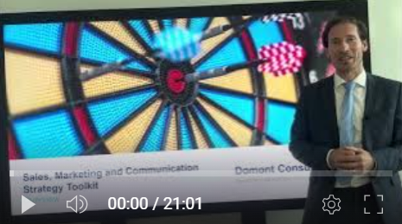
Video demonstration of the Toolkit
Video Demo Access
Video Demo Visual
Select “Slide Show” mode and then click on the link below or on the image on the right to access this video demo.
You can also access the video by copy pasting the following URL in your browser:
https://youtu.be/gkz-s7rnZ_s

Slide 8
Our Toolkit will help you fulfill multiple objectives
The Sales, Marketing, Pricing & Communication Strategy Toolkit includes frameworks, tools, templates, tutorials, real-life examples, video training, and best practices to help you:
Define and Implement your Sales & Marketing Strategy: (1) Market analysis, (2) Competitor analysis, (3) Sales analysis, (4) Marketing analysis, (5) Funnel process, (6) Company swot analysis, (7) Strategy frameworks, (8) Sales function vision, mission & values, (9) Marketing function vision, mission & values, (10) Sales strategic objectives & KPIs to reach our vision, (11) Marketing strategic objectives & KPIs to reach our vision, (12) Sales team & budget, (13) Marketing team & budget, (14) Five pillars: Product/Service positioning & value proposition, Communication strategy, Sales distribution strategy, Pricing strategy, and Digital strategy
Define your Product/Service Positioning & Value Proposition: (1) Target market, (2) Product/service offering, (3) Product life cycle, (4) Product/service positioning: Key attributes, customer benefits & unique selling proposition (USP), (5) Value proposition, (6) Product packaging and design, (7) Product bundling, (8) Customer feedback integration
Define and Implement your Communication Strategy: (1) Background & context, (2) Communication objectives, (3) Approach, (4) Communication principles, (5) Overarching messages, (6) Stakeholder analysis, (7) Communication channels, (8) Key dependencies, (9) Communication risks, (10) High-level communication plan, (11) Detailed communication plan
Define and Implement your Sales Distribution Strategy: (1) Retail distribution, (2) Wholesale distribution, (3) Online distribution, (4) Own physical store distribution, (5) Franchising, (6) Strategic partnerships, (7) Multi-channel distribution, (8) Sales team structure, (9) Sales distribution strategy selection matrix
Define and Implement your Pricing Strategy: (1) Pricing fundamentals, (2) Pricing maturity model, (3) Current and target pricing maturity levels, (4) Pricing strategies, (5) Price sensitivity analysis, (6) Setting up prices, (7) Discount strategies, (8) Avoiding price war, (9) Performance monitoring
Define and Implement your Digital Strategy: (1) Branding guidelines, (2) Website design and development, (3) Search engine optimization, (4) Pay per click strategy, (5) Social media strategy, (6) Emailing strategy
List your Potential Initiatives for each pillar
Create your Business Cases and Financial Models to assess Potential Initiatives
Prioritize, Plan and Implement your Projects: (1) Project Prioritization, (2) Business Roadmap, (3) Governance, (4) Dashboards, (5) Project Implementation: Agile Methodology, Design Thinking and Traditional Methodology, (6) Continuous Improvement (7) Post Projects Evaluation and Lessons Learnt, (8) Post Program Evaluation and Lessons Learnt
Define and implement your change management strategy and internal communication strategy: (1) Change management strategy, (2) Change management plans, (3) Implementation, tracking and progress management, (4) Effective communication, (5) Stakeholder engagement strategy
1
2
3
4
5
6
7
8
9
10

Slide 9





The Toolkit includes a 6-phase approach that we have built and refined over the past 20 years through constant trial and error
I. Sales & Marketing Strategy
Market Analysis
Sales Analysis
Funnel Process
Strategy Frameworks
Sales Function Vision, Mission & Values
Sales Strategic Objectives & KPIs to reach our Vision
Sales Team & Budget
Ansoff Matrix
Blue Ocean Strategy
Entering a New Market
Introducing a New Product
Segmentation, Targeting & Positioning
Competitor Analysis
Marketing Analysis
Company SWOT Analysis
Marketing Function Vision, Mission & Values
Marketing Strategic Objectives & KPIs to reach our Vision
Marketing Team & Budget
II. Five Pillars to reach our Sales & Marketing Strategic Objectives
Product/Service Positioning & Value Proposition
Communication Strategy
Sales Distribution Strategy
Pricing Strategy
Digital Strategy
Target market
Product/service offering
Product life cycle
Product/service positioning: Key attributes, customer benefits & unique selling proposition (USP)
Value proposition
Product packaging and design
Product bundling
Customer feedback integration
Background & context
Communication objectives
Approach
Communication principles
Overarching messages
Stakeholder analysis
Communication channels
Key dependencies
Communication risks
High-level communication plan
Detailed communication plan
Retail distribution
Wholesale distribution
Online distribution
Own physical store distribution
Franchising
Strategic partnerships
Multi-channel distribution
Sales team structure
Sales distribution strategy selection matrix
Pricing fundamentals
Pricing maturity model
Current and target pricing maturity levels
Pricing strategies
Price sensitivity analysis
Setting up prices
Discount strategies
Avoiding price war
Performance monitoring
Branding guidelines
Website design and development
Search engine optimization (SEO)
Pay per click (PPC) strategy
Social media strategy
Emailing strategy
III. Potential Initiatives for each Pillar
IV. Business Cases and Financial Models to assess Potential Projects
V. Project Prioritization, Business Roadmap and Implementation
VI. Change Management, Internal Communication and Stakeholder Engagement

Slide 10
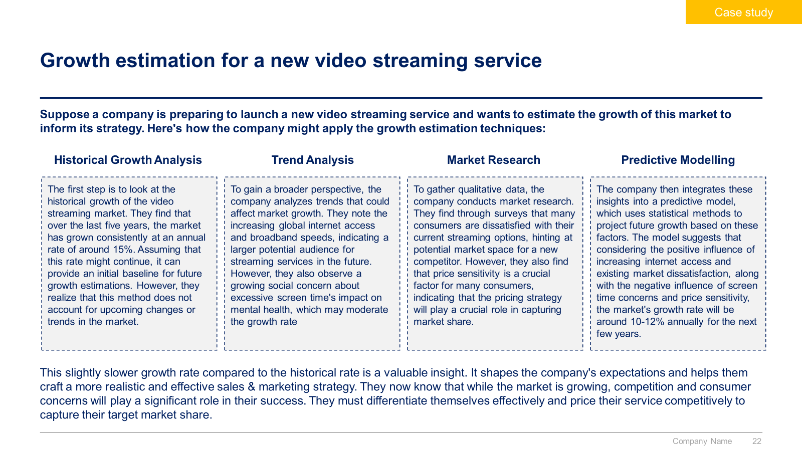
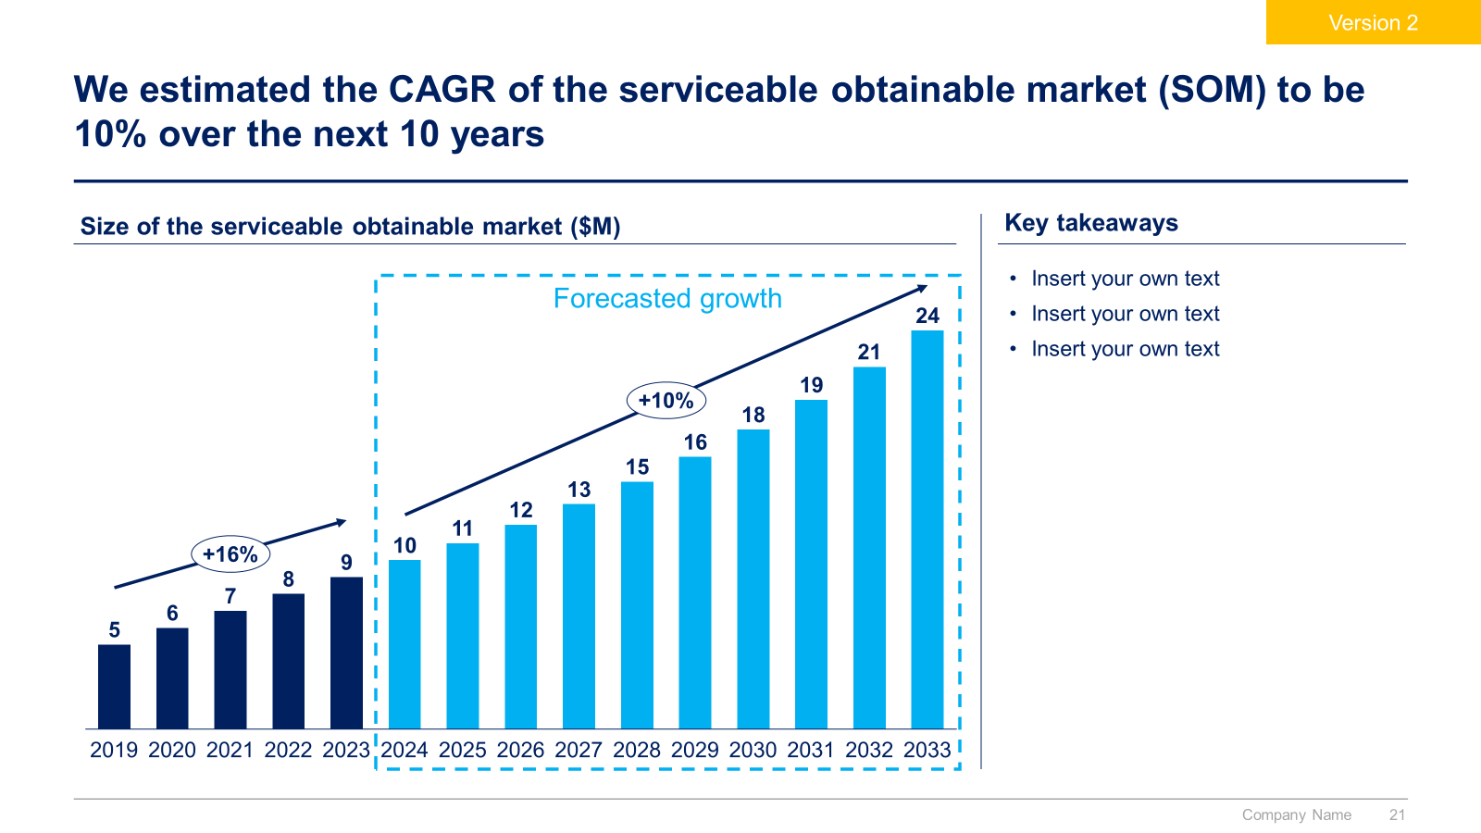
Small preview of the phase 1 ‘Sales & Marketing Strategy’

Slide 11
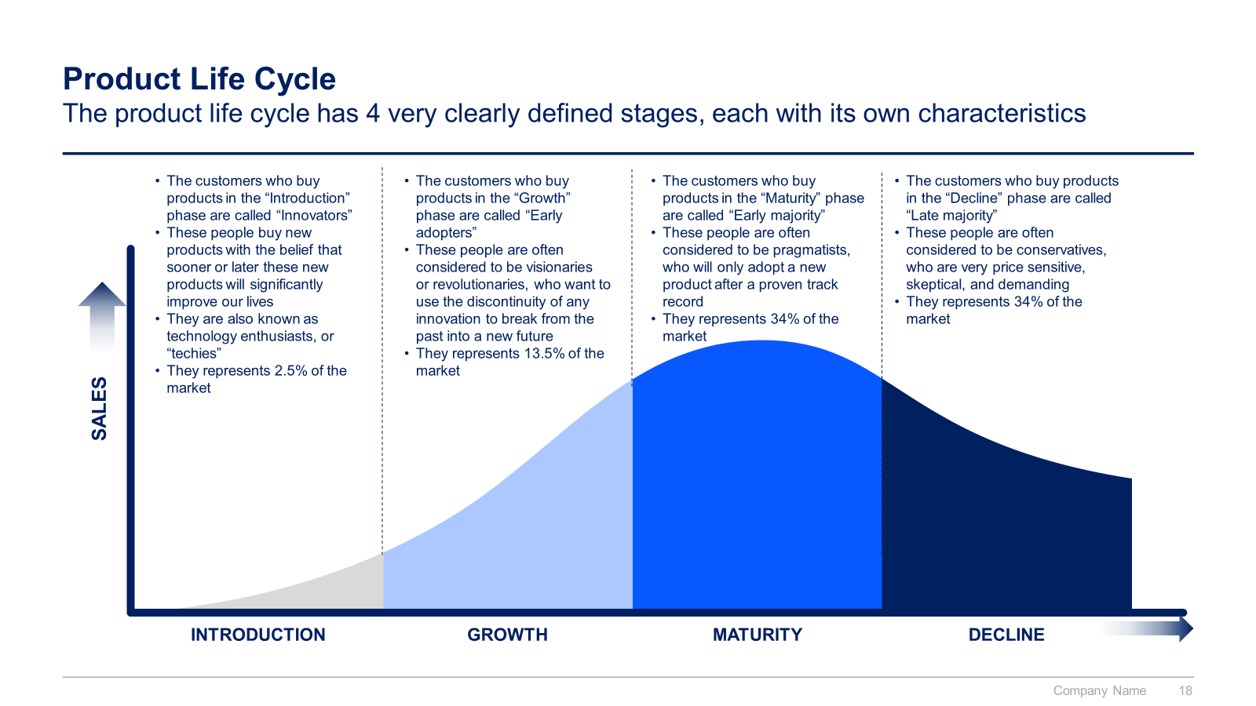
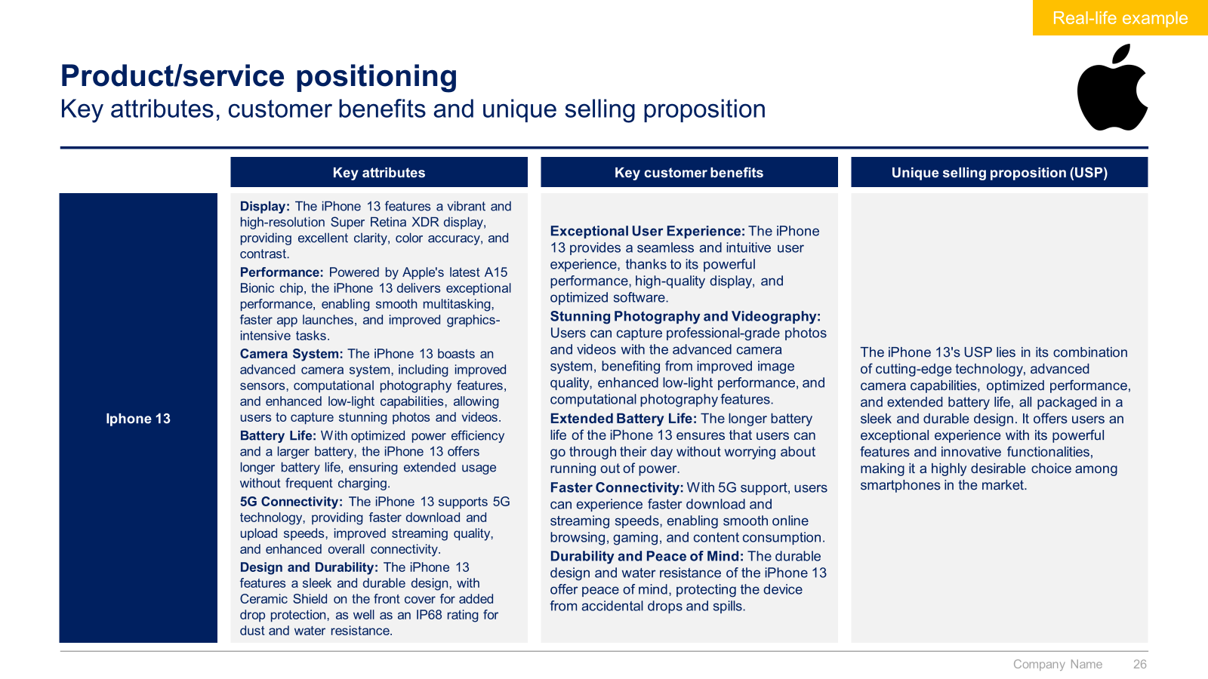
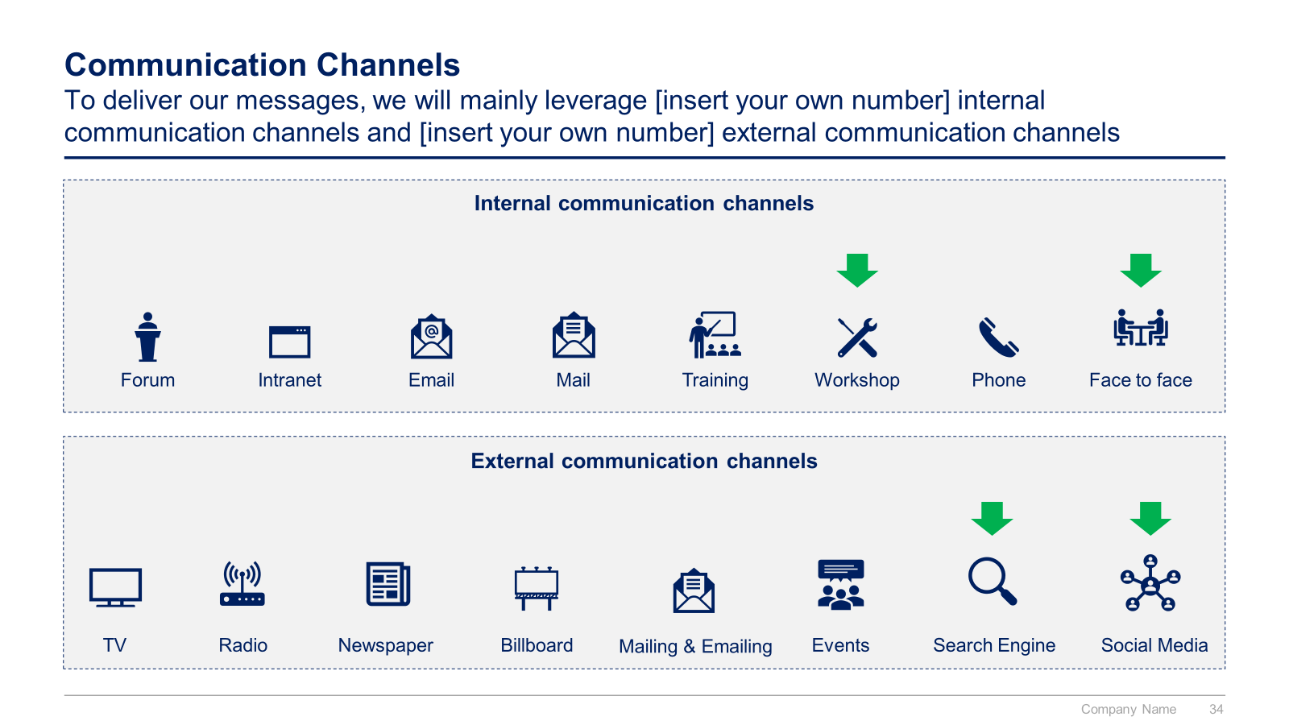
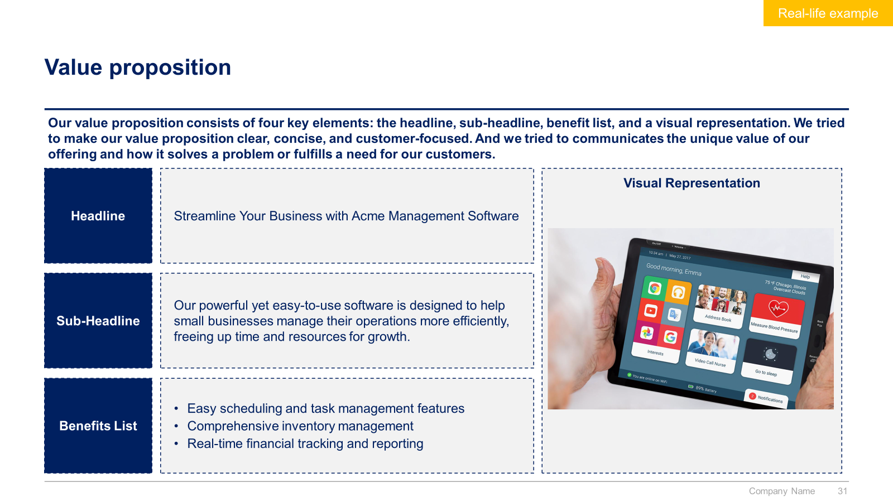
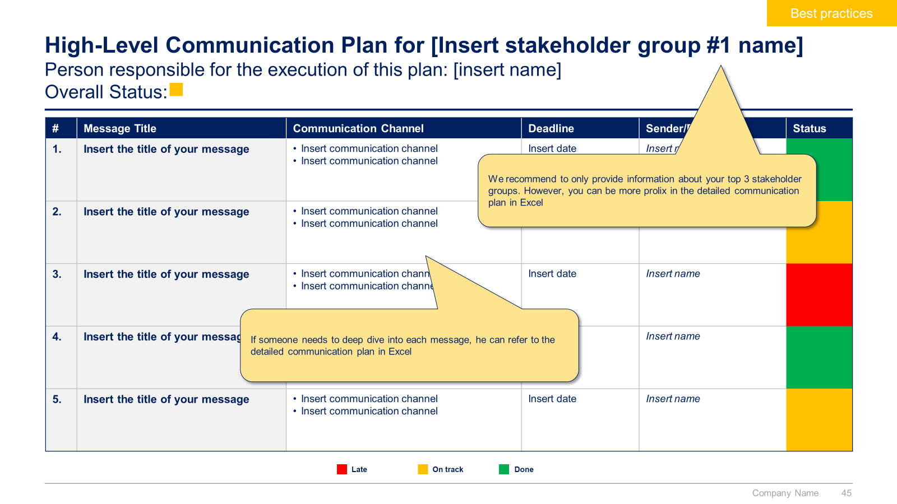
Small preview of the phase 2 ‘5 Pillars to reach our Sales & Marketing Strategic Objectives’ (1/3)

Slide 12
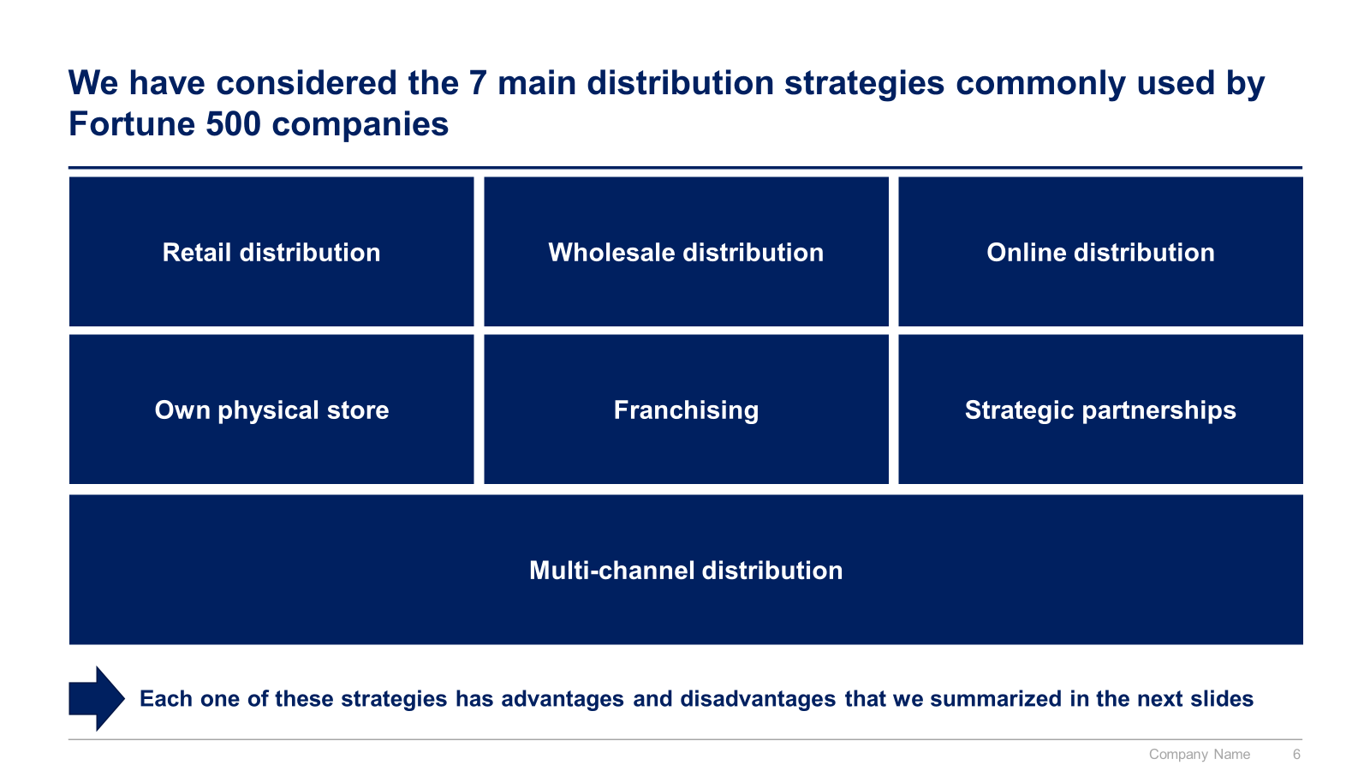
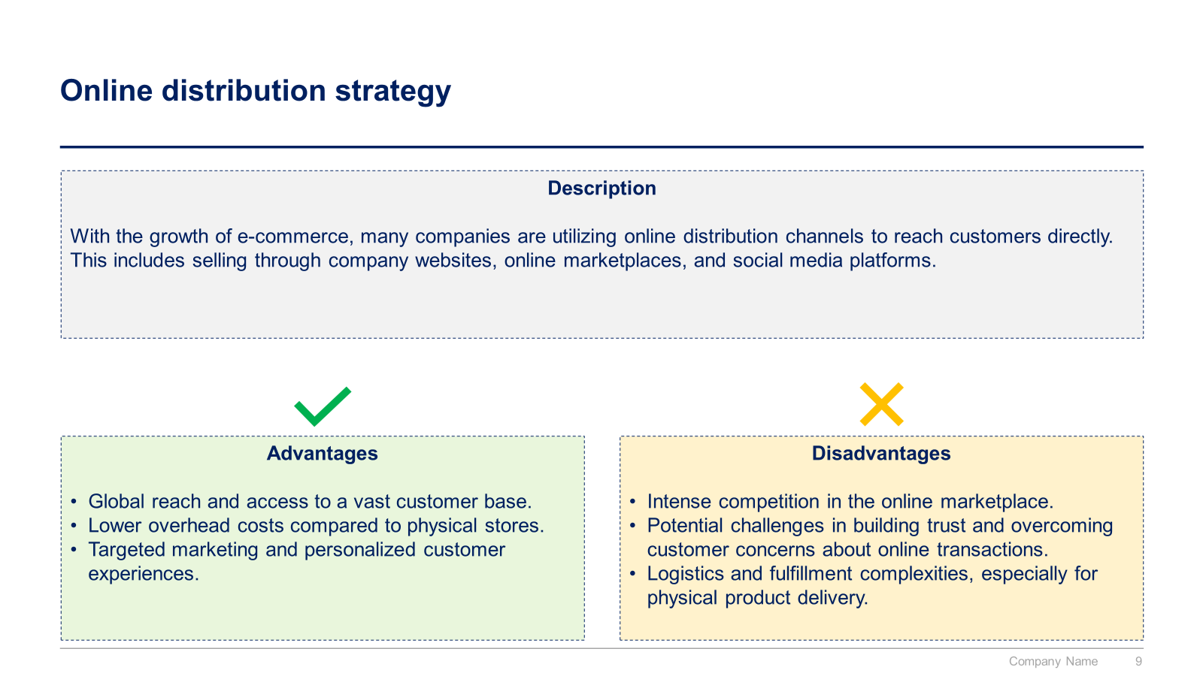
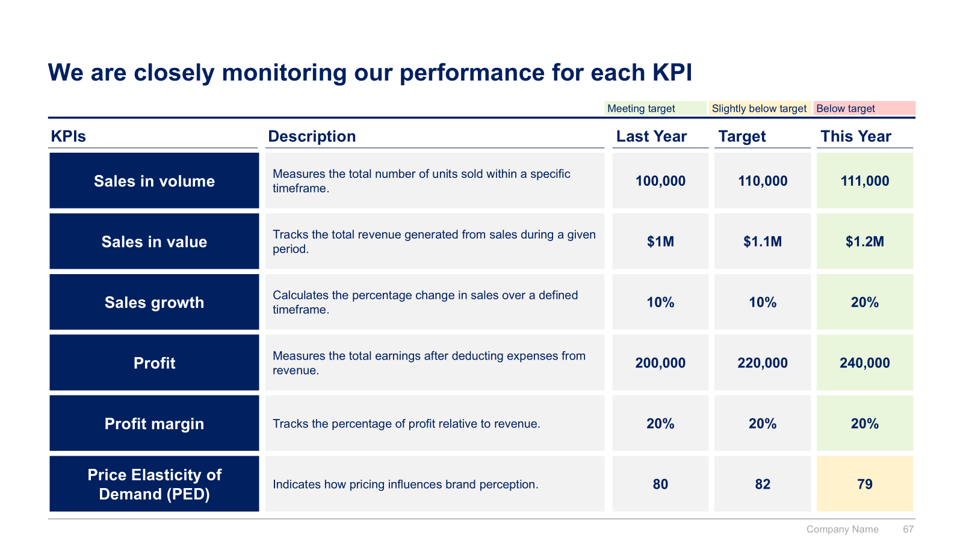
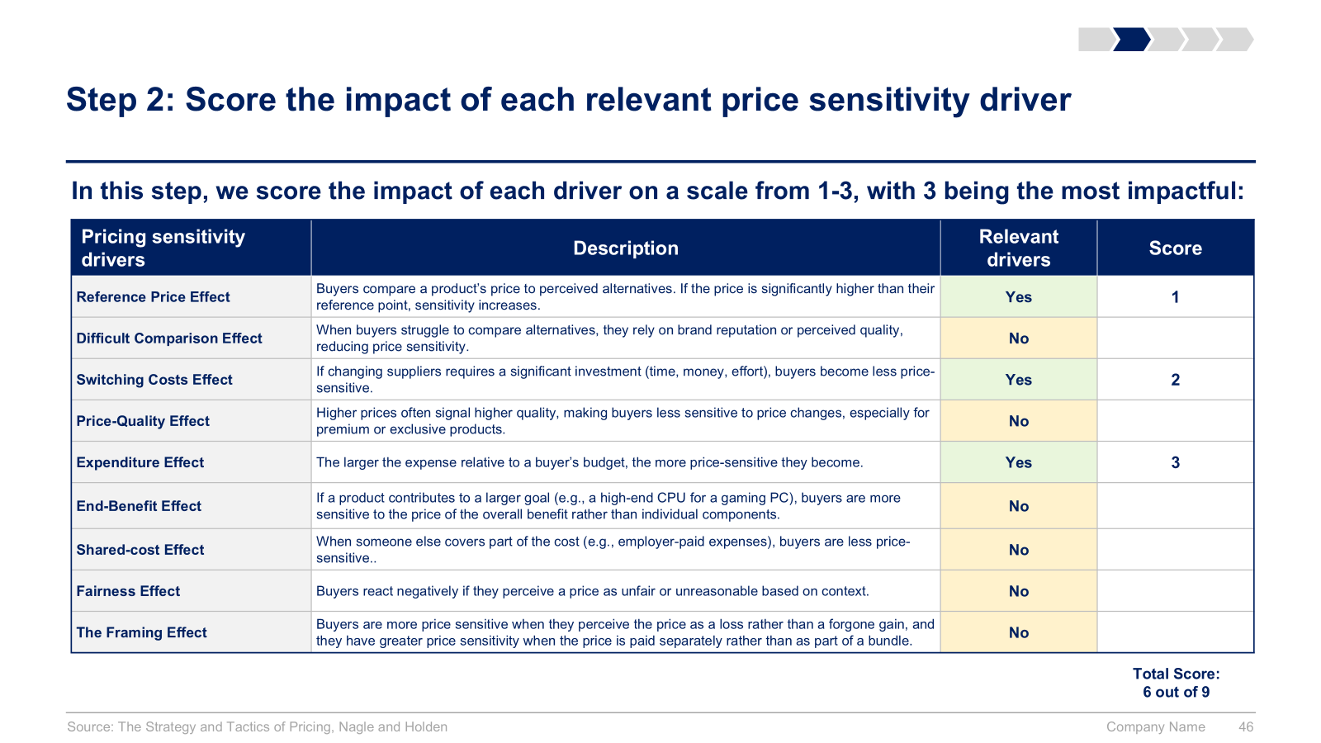
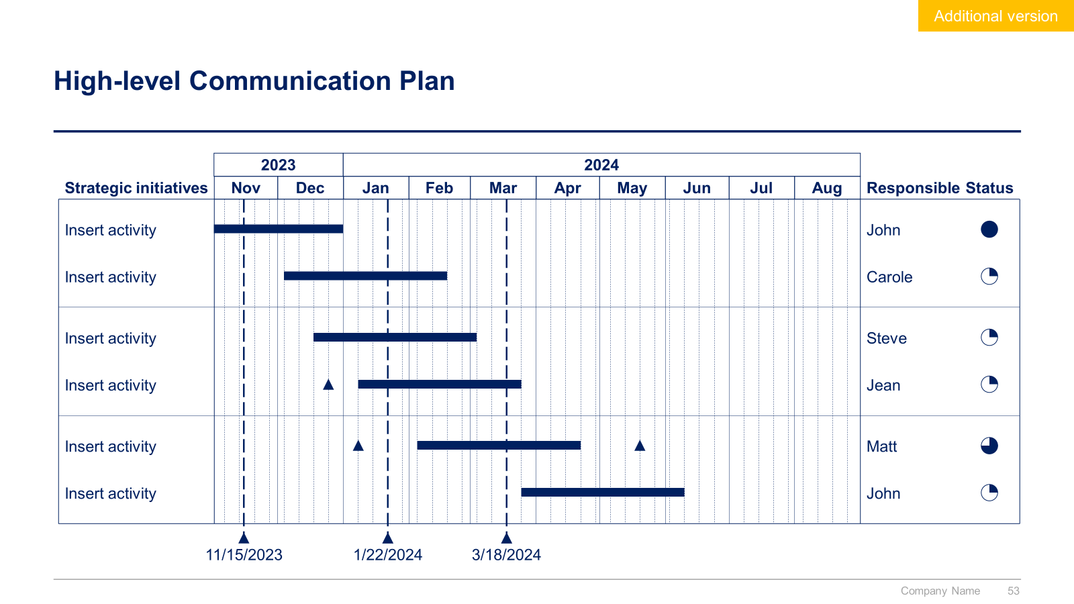
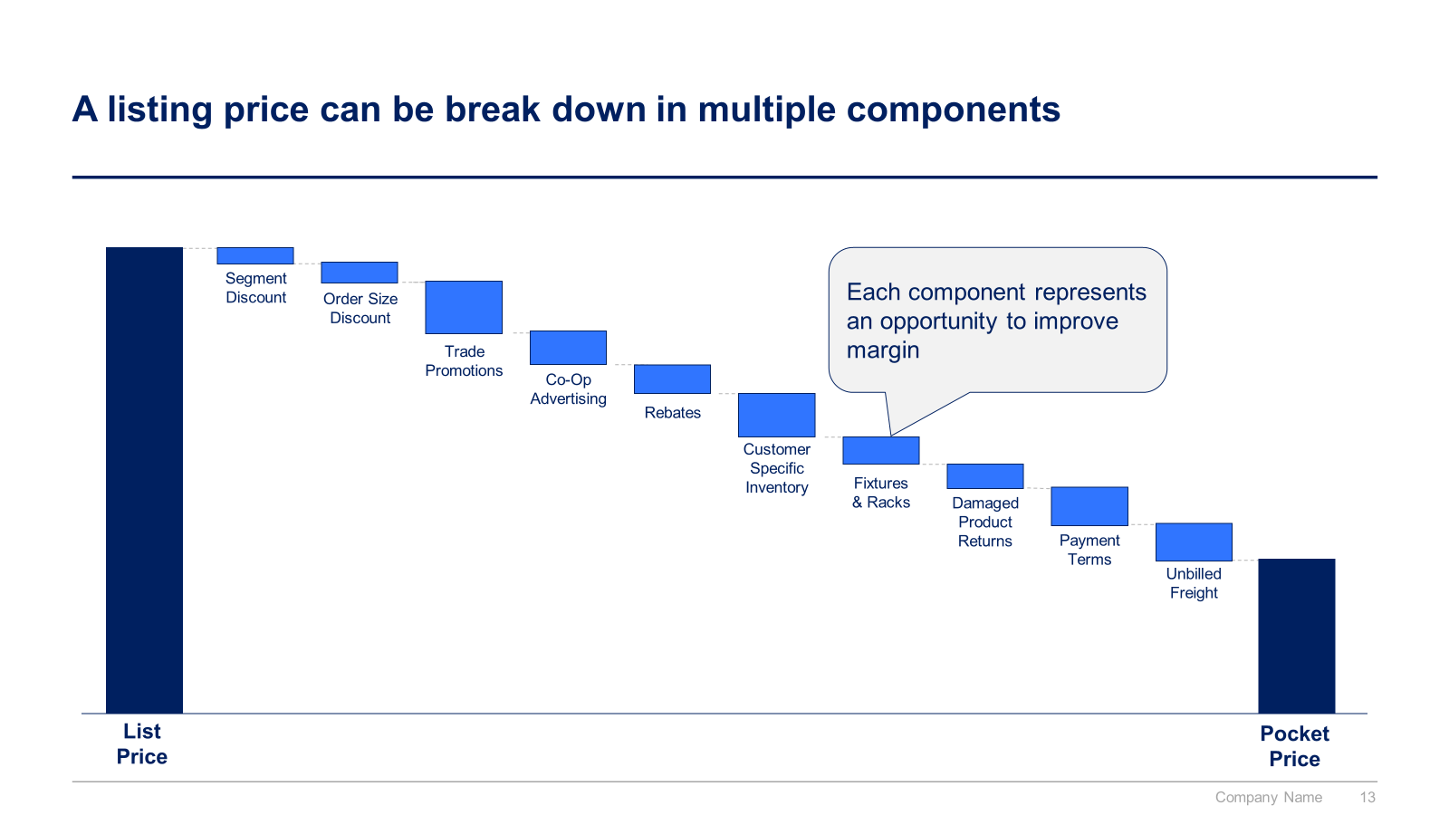
Small preview of the phase 2 ‘5 Pillars to reach our Sales & Marketing Strategic Objectives’ (2/3)

Slide 13
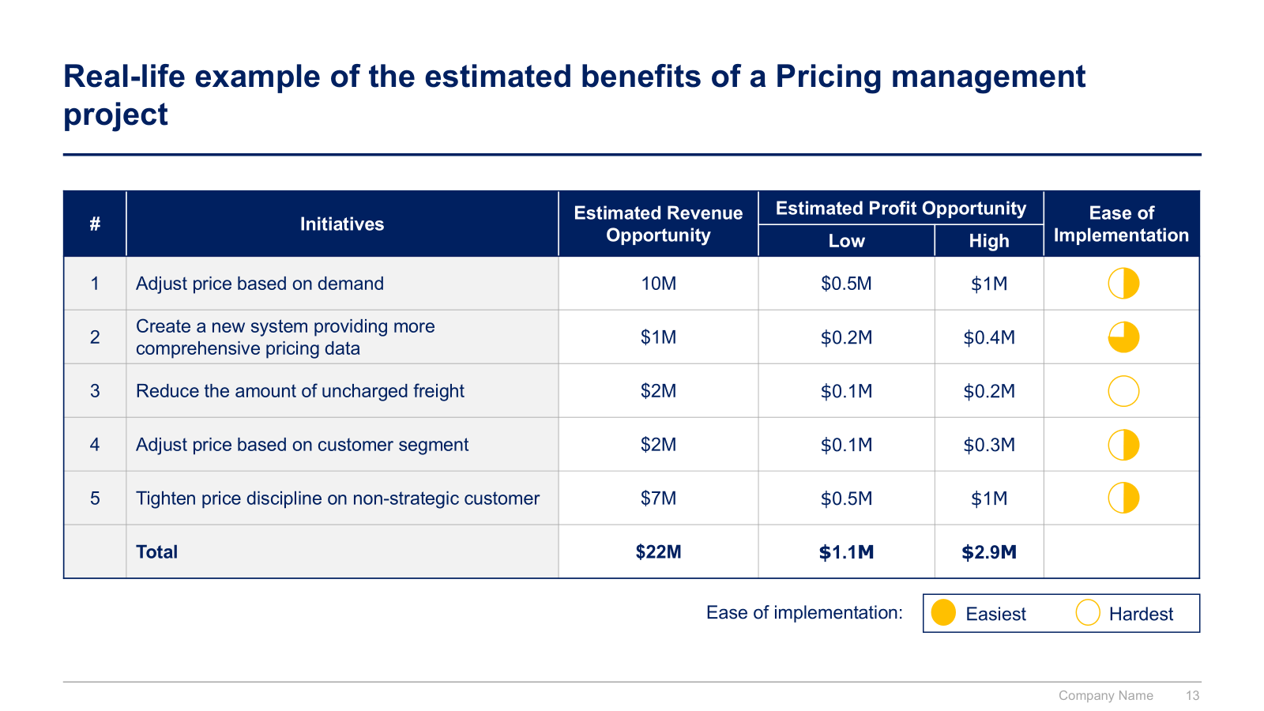
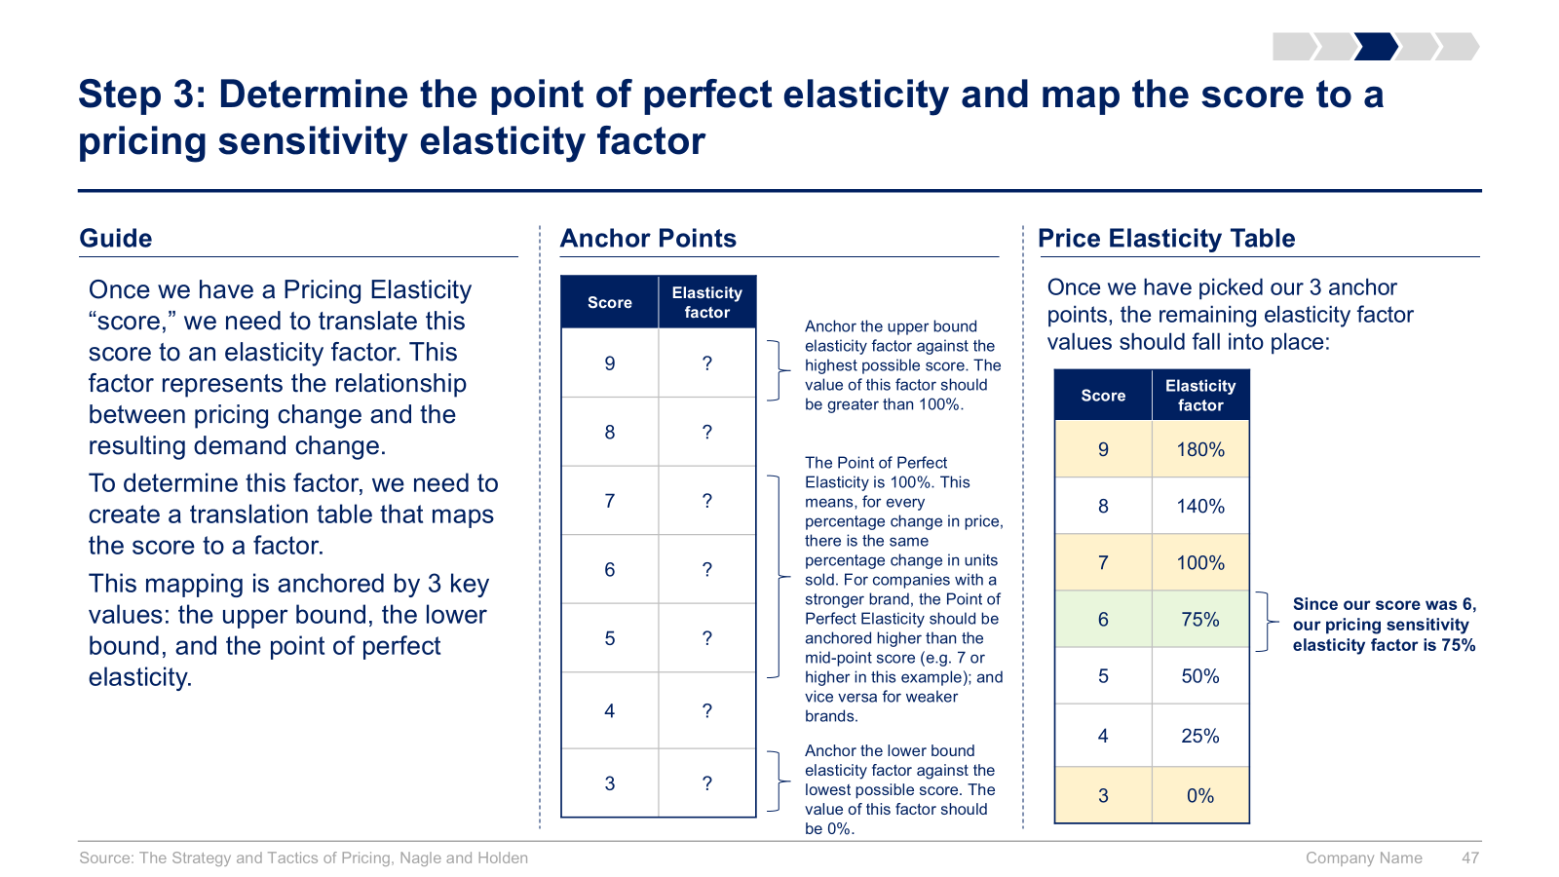
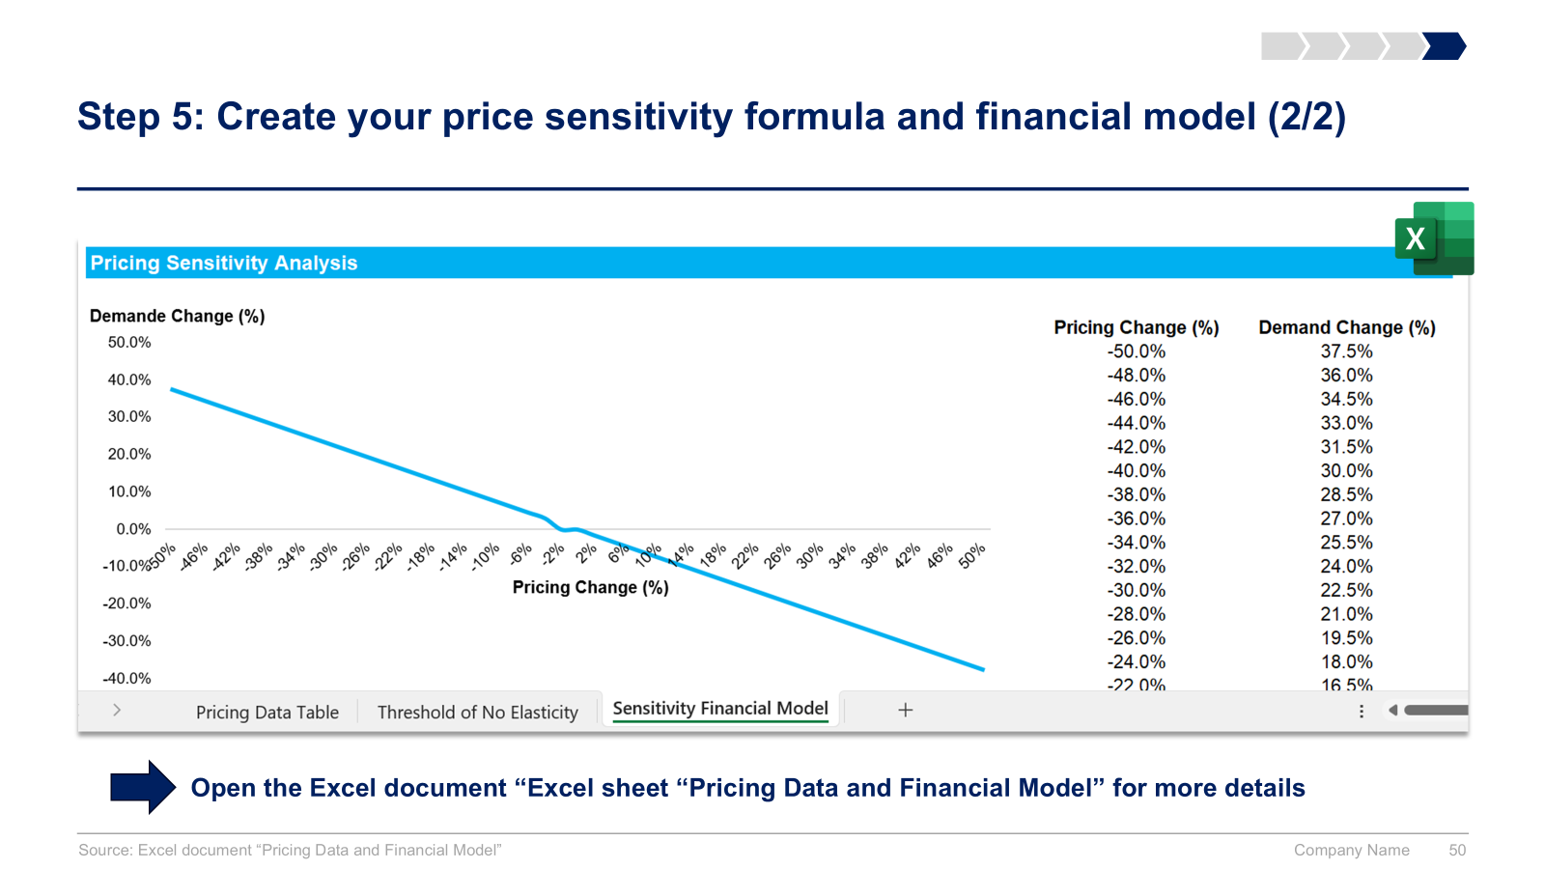
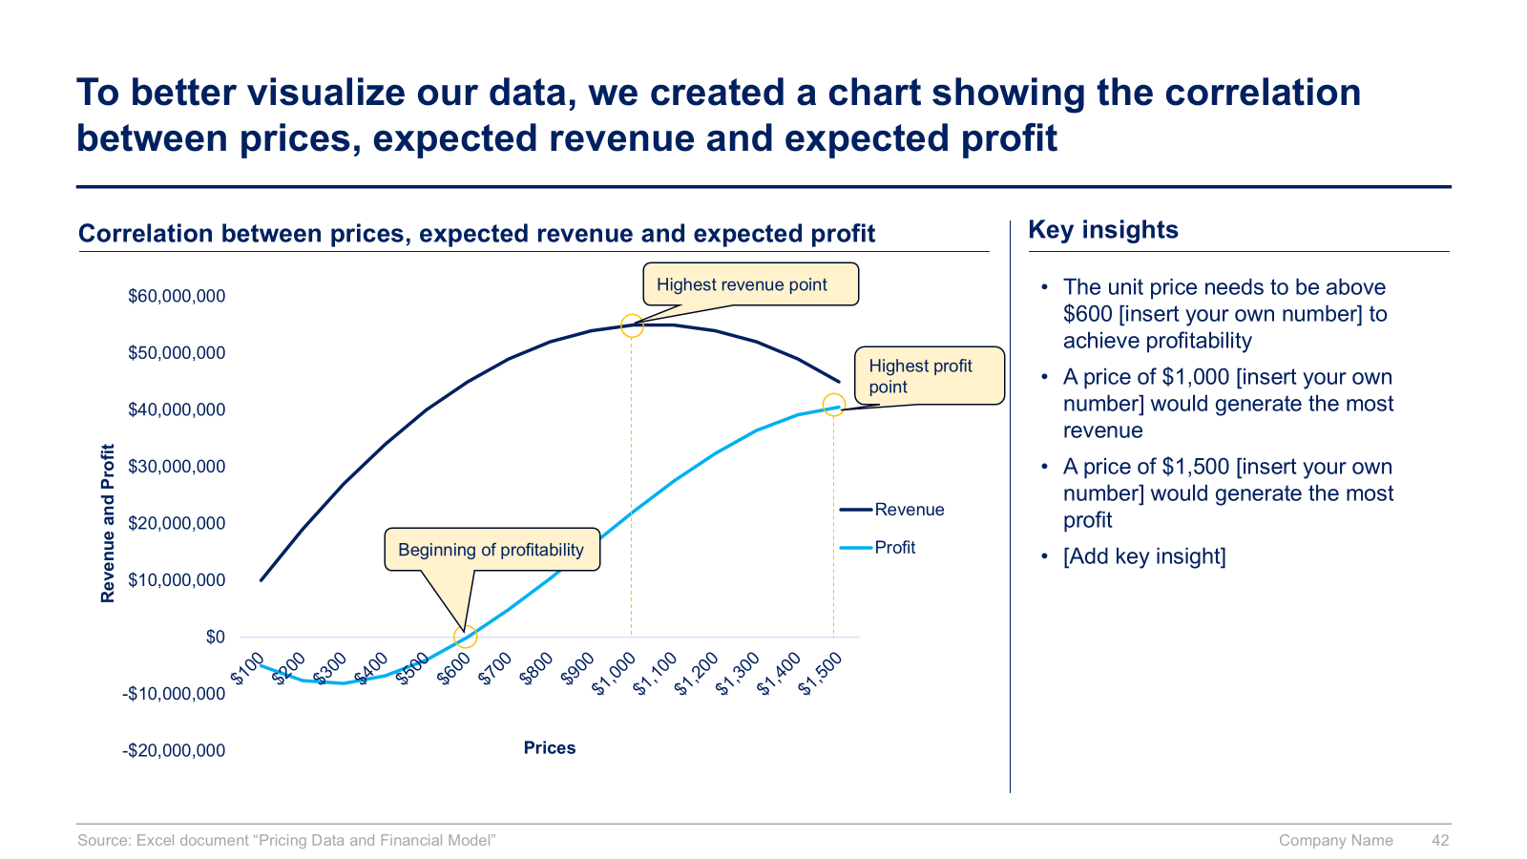
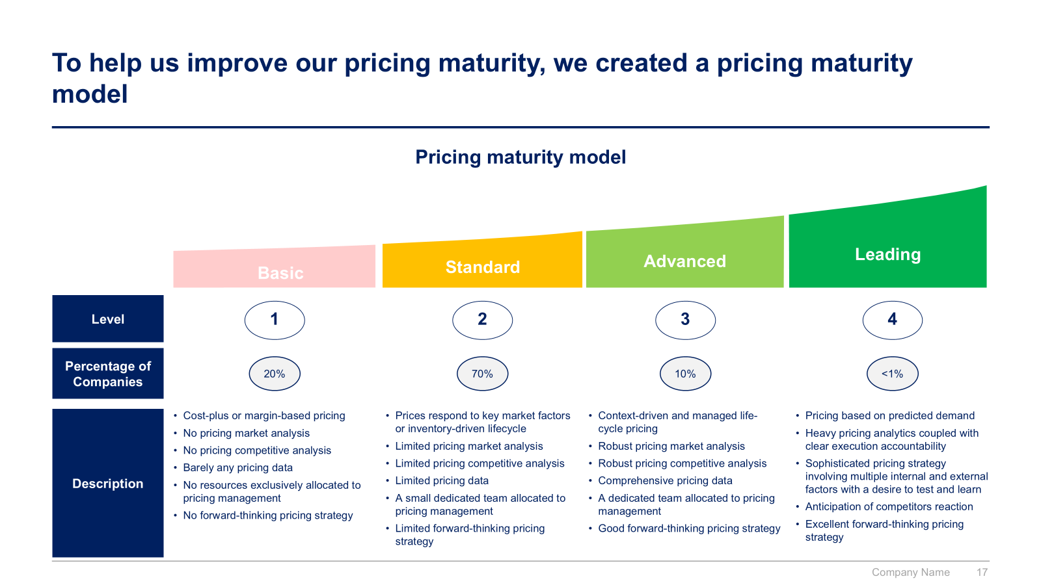
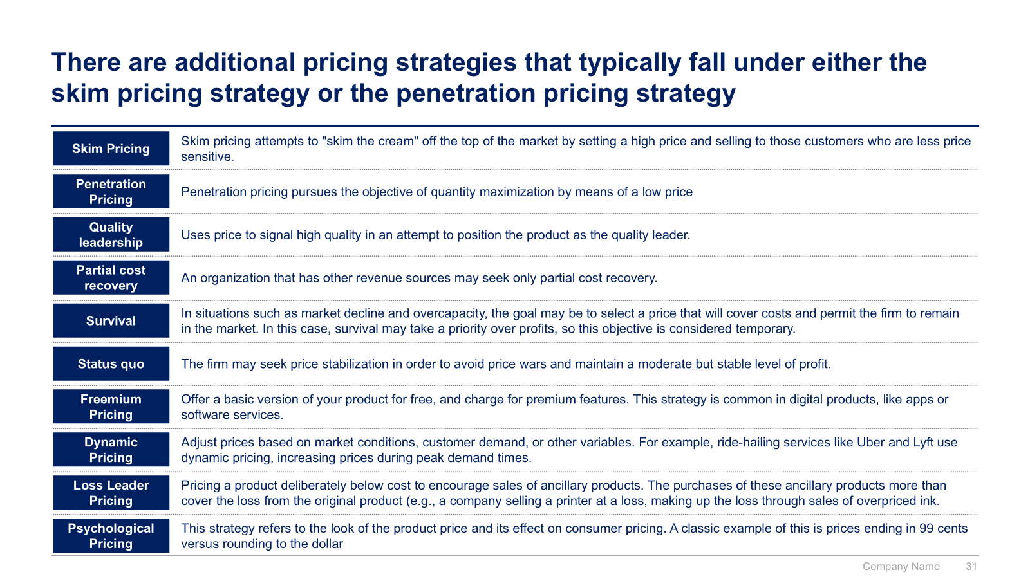
Small preview of the phase 2 ‘5 Pillars to reach our Sales & Marketing Strategic Objectives’ (3/3)

Slide 14
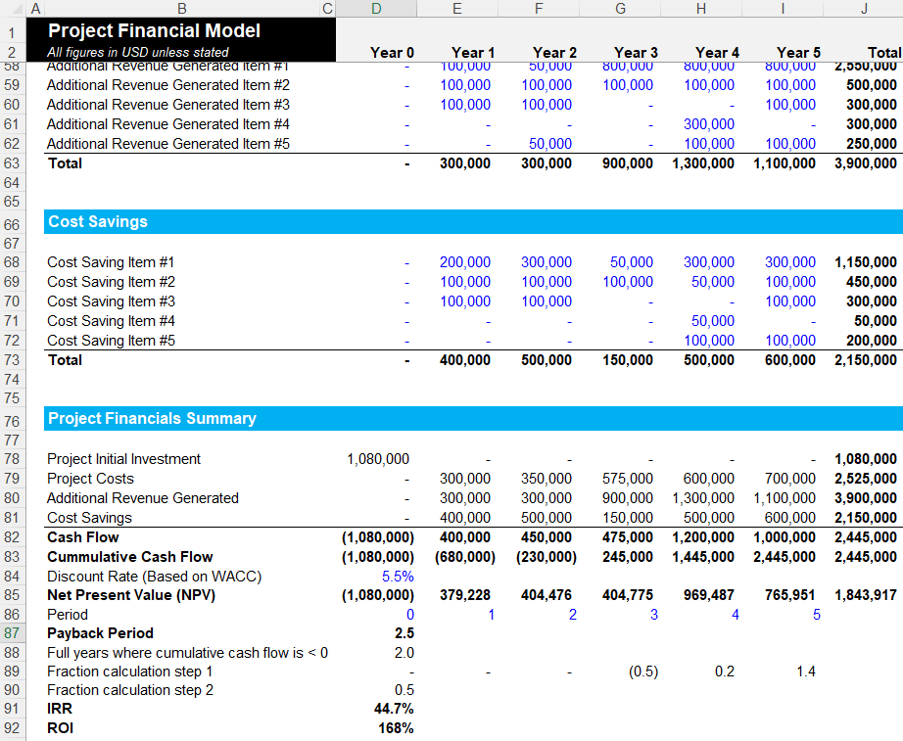
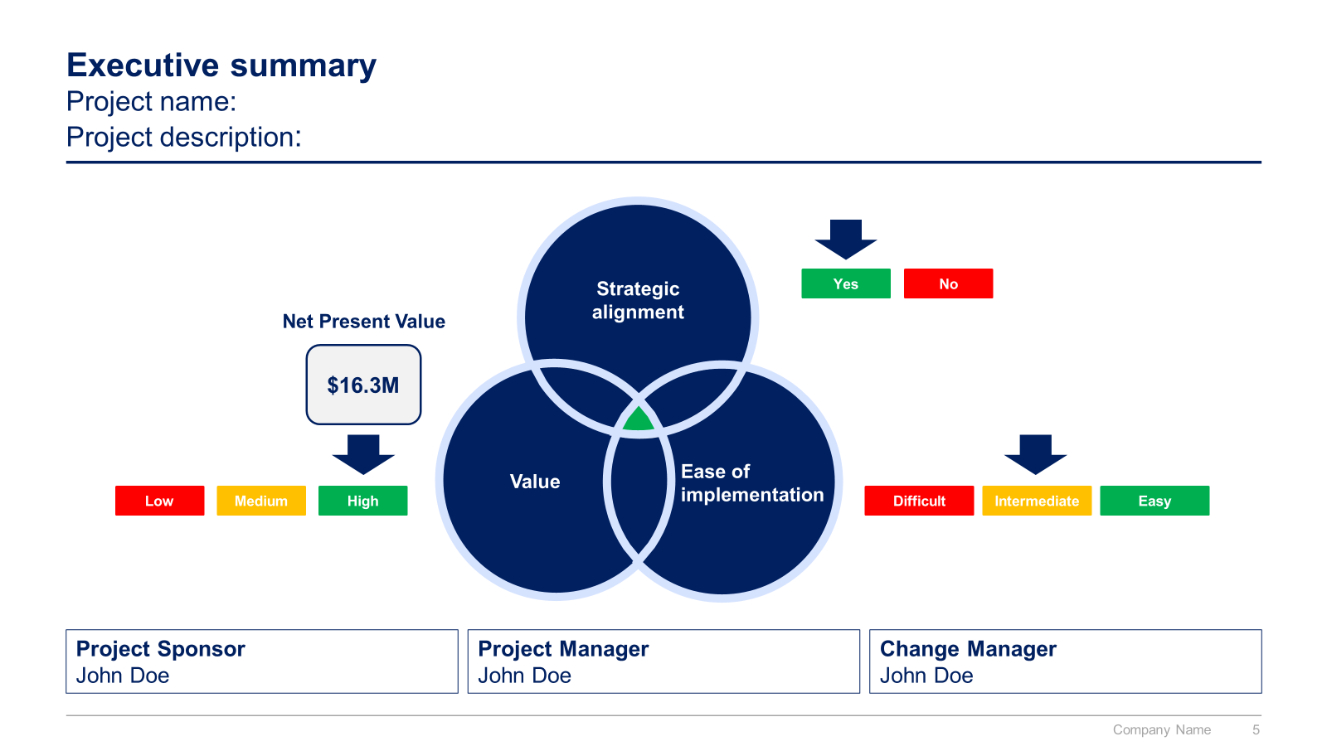
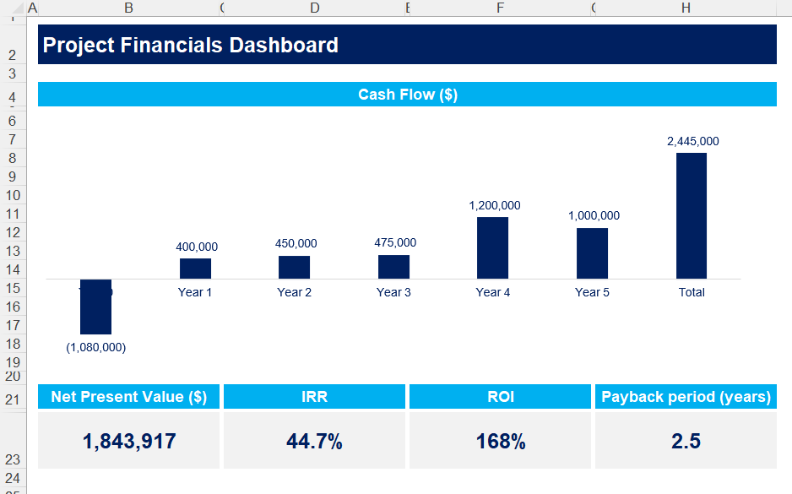
Small preview of the phase 3 ‘Potential Initiatives’ and 4 ‘Business cases and financial models’

Slide 15

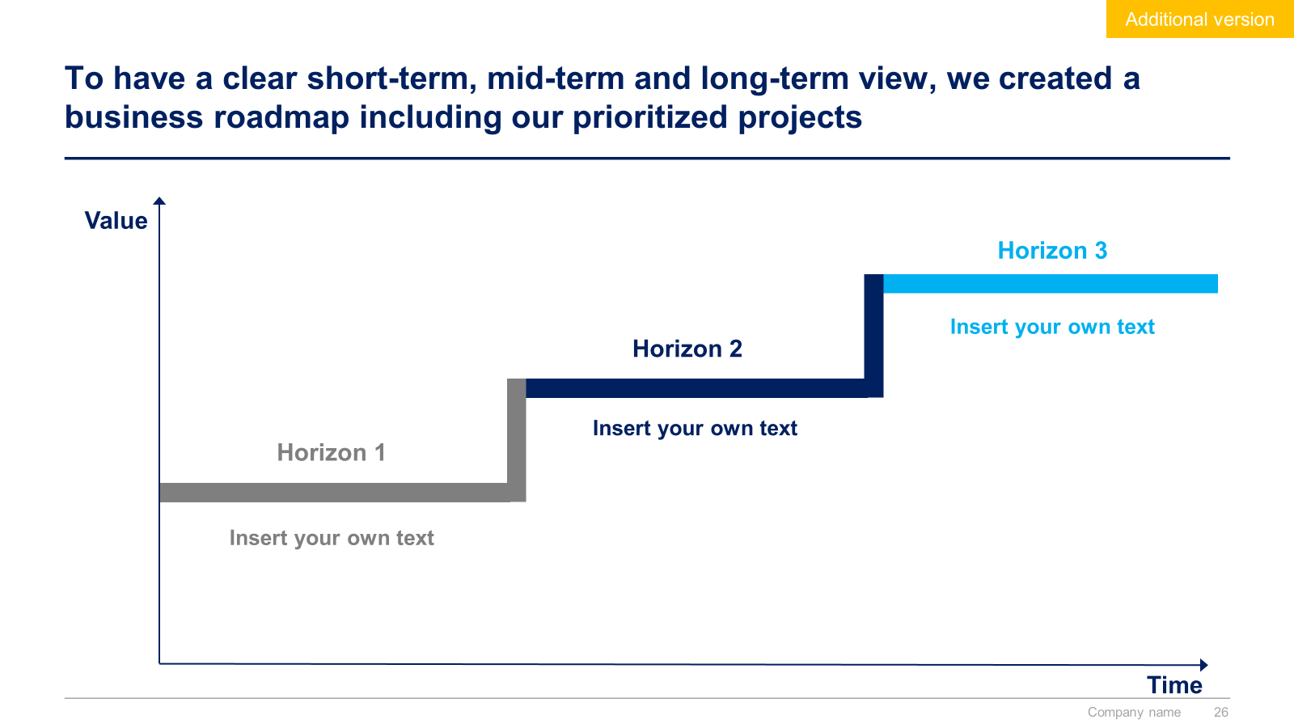
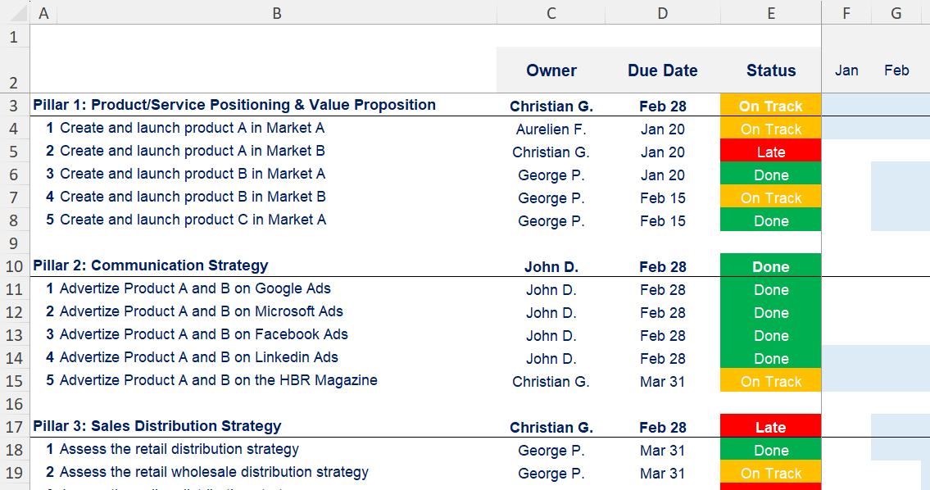
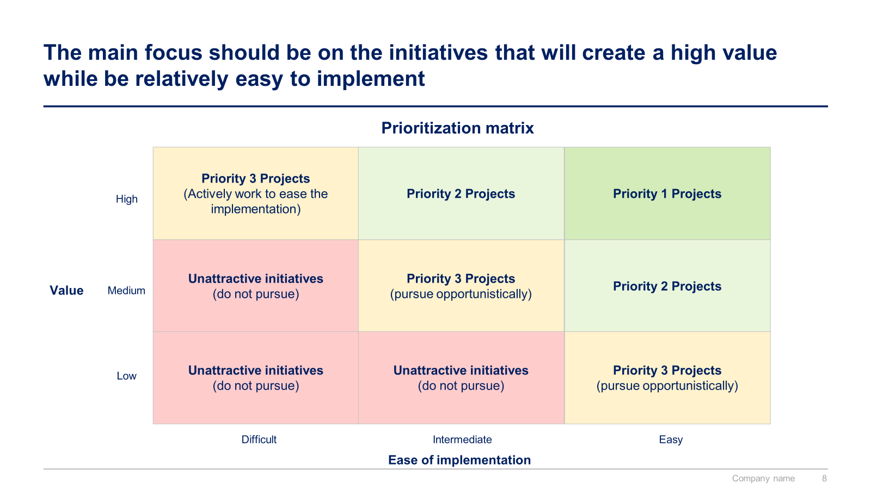
Small preview of the phase 5 ‘Project Prioritization, Business Roadmap and Implementation’

Slide 16
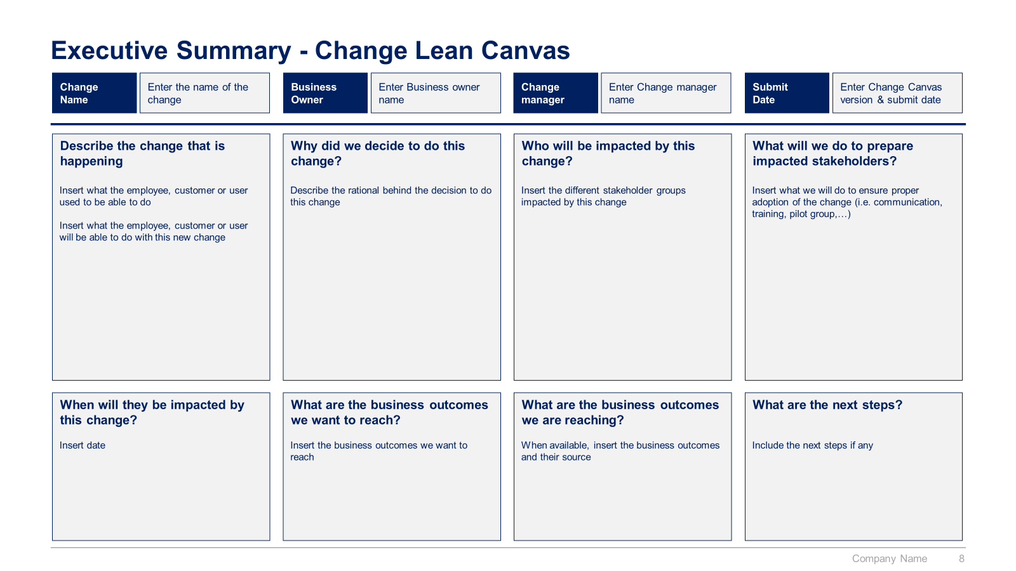
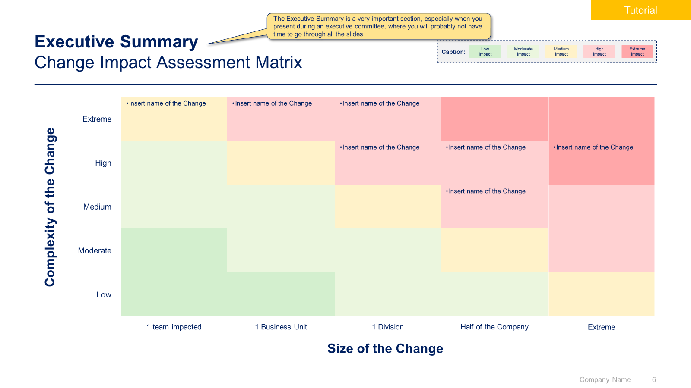
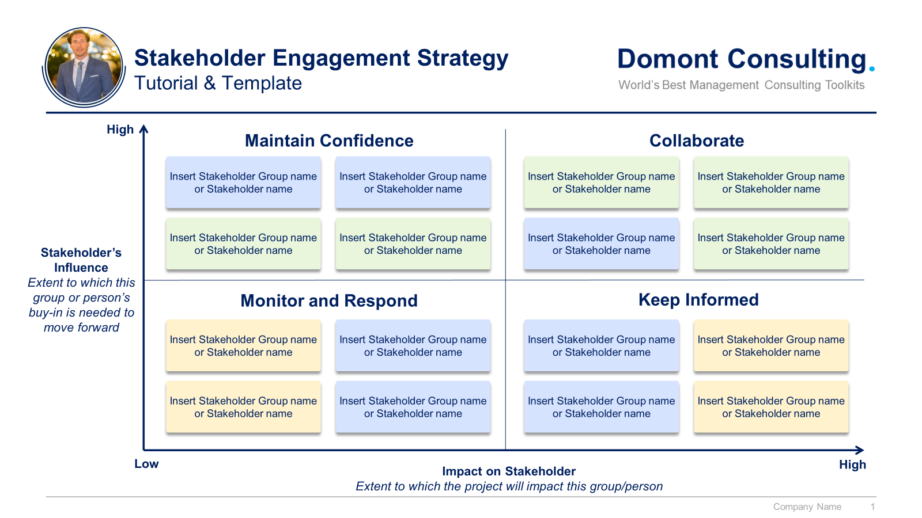
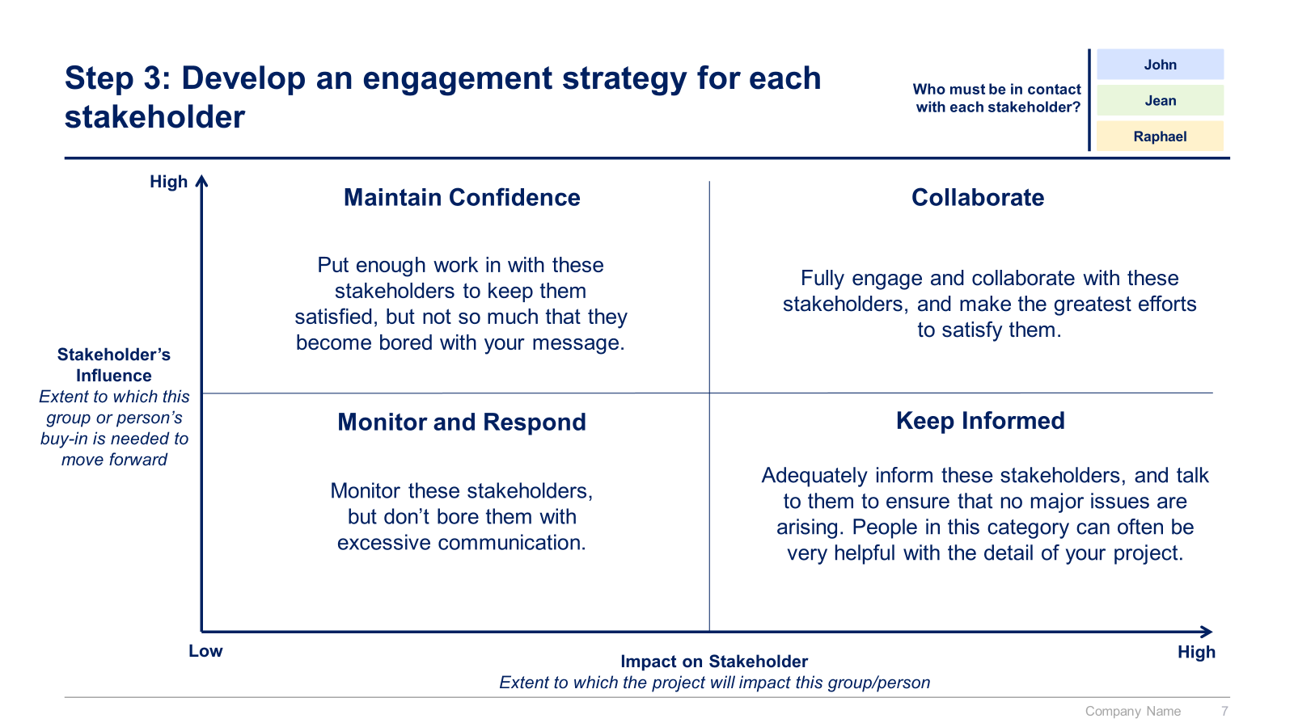
Small preview of the phase 6 ‘Change Management, Internal Communication and Stakeholder Engagement’

Slide 17



The Toolkit includes multiple PowerPoint slides, Excel sheets and Video training that you can download on your device immediately after purchase
750 editable PowerPoint slides*
35 Excel sheets*
1 hour of Video training
Overview and Approach
Sales and Marketing Strategy
Value Proposition
Communication Strategy
Sales Distribution Strategy
Pricing Strategy
Digital Strategy
List of Potential Initiatives
Business Cases and Financial Models
Project Prioritization, Business Roadmap and Implementation
Change Management, Internal Communication & Stakeholder Engagement
*Please note that the number of Powerpoint slides and Excel sheets listed is the number of unique slides and sheets. For example, a Powerpoint slide that has been duplicated to facilitate our clients’ understanding only counts for one slide

Slide 18









Our Management Consulting Toolkits include 9 key benefits
Improve the growth & efficiency of your organization by leveraging Management Consulting Toolkits created by ex-McKinsey, Deloitte & BCG Consultants.
Make a great investment for your career & organization. It cost us US$8M+ over the past 10 years to create all our Toolkits. Get them for a fraction of this cost.
Get a competitive advantage. It’s like hiring Management Consultants to create all the practical Frameworks, Tools & Templates you need.
Get the job done quicker and never start from scratch again with our ready-made and fully editable Frameworks, Tools & Templates in Powerpoint & Excel.
Don't reinvent the wheel. We have already worked 30,000+ hours over the past 10 years to create all the Management Consulting Toolkits you need.
Improve the capabilities of your organization by learning how the Fortune 100 and Global Consulting Firms do it.
Decrease your costs. Hiring tier-1 Consultants for a project would cost you $300k+. Way more expensive than our Toolkits, which will last you a lifetime!
Become your organization’s subject matter expert and impress your stakeholders with world-class approaches to resolve common business problems.
Get free support and advice from our ex-McKinsey, Deloitte & BCG Management Consultants.

Slide 19
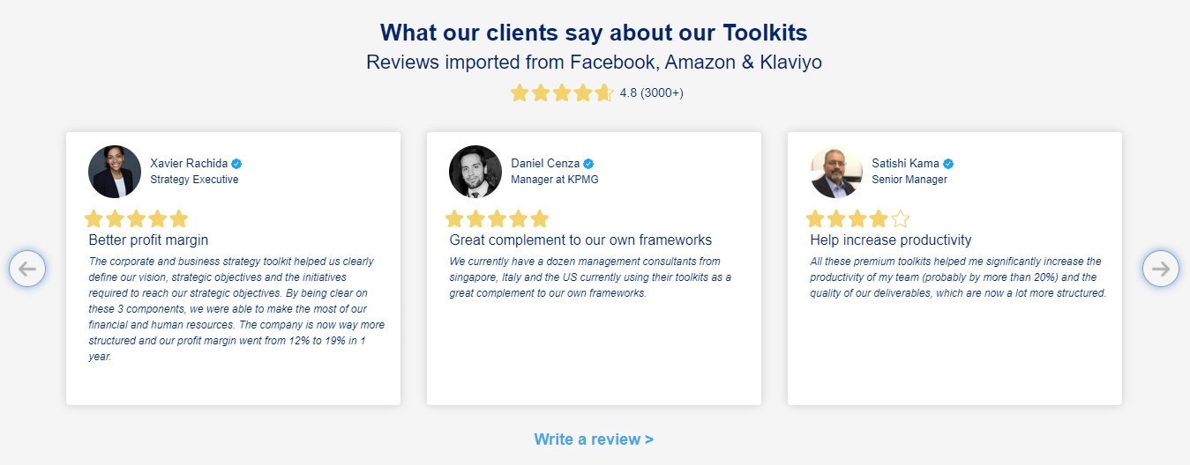
What our clients say about our Toolkits
Click here to see more reviews >

Slide 20

Join 200,000+ Executives, Consultants & Entrepreneurs leveraging our Toolkits to improve the performance of their organization
Trusted by small and large organizations
Customer satisfaction
4.8
Number of countries leveraging our Toolkits
160+
Number of professionals leveraging our Toolkits
200,000+
Daily rate of our ex-McKinsey, Deloitte and BCG Management Consultants
$3k-$4k

Slide 21

Interested in more than 1 Toolkit? Access all our Toolkits for half the price with our Gold Access
Gold Access
Click here to learn more

Slide 22
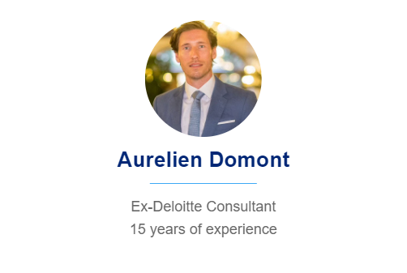

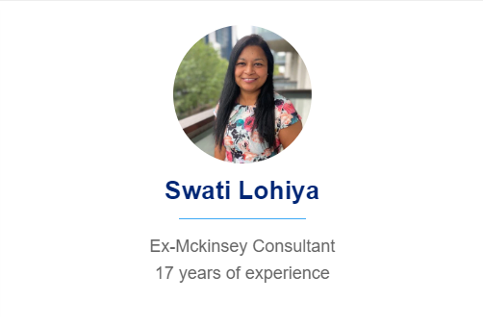

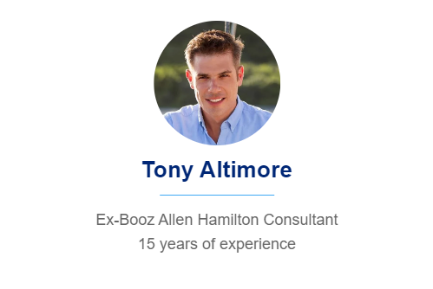
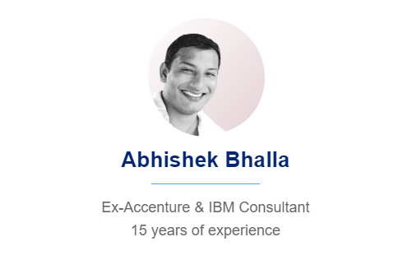
Need additional help? Send us a brief and we’ll find you the right talent from our network of 500+ tier-1 Management Consultants
Click here to send us a Project Brief

Slide 23

This was just a small preview.
www.domontconsulting.com

